Slide 1
Accessing Database with ADO.NET

Slide 2
Objectives
Overview ADO.NET
Explain ADO.NET data access history
Describe data access architecture in .NET
Explain the benefits of ADO.NET
Describe the connected and disconnected data access approach
Demo using ADO.NET Data Provider Factory Model
Demo accessing database in WinForm Application using ADO.NET
Demo using Store procedures in ADO.NET
Overview about 3-Layers and 3-Tiers Architecture

Slide 3
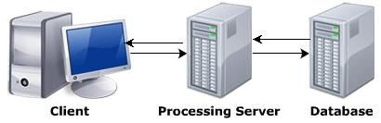
What is Database?
Database is a collection of related records
The information in DB is stored in such a way that it is easier to access, manage, and update the data
Data from the DB can be accessed using any one of the following architectures:
Single-tier architecture
Two-tier architecture
Three-tier architecture

Slide 4
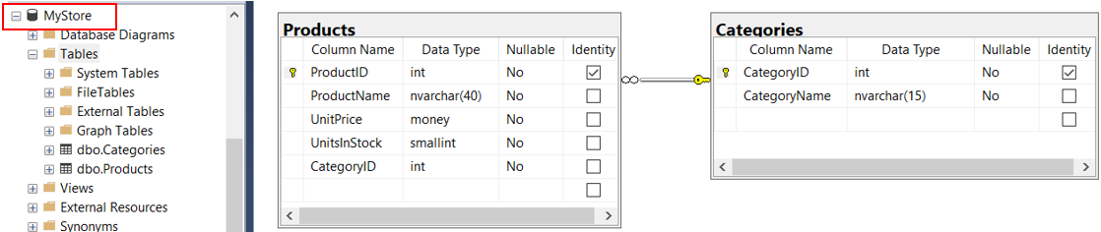
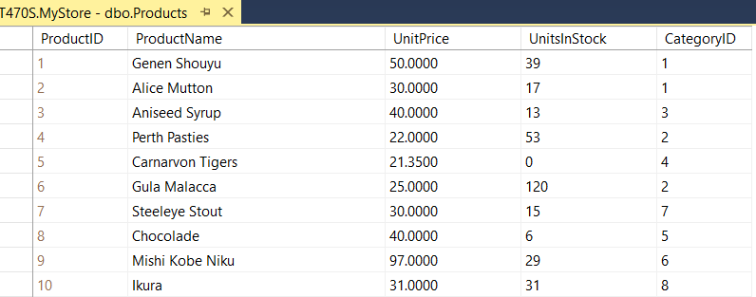
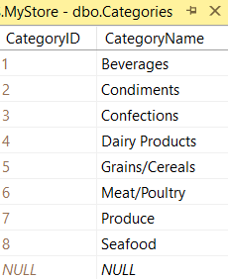
Create a sample database named MyStore for demonstrations

Slide 5
ADO.NET Data Access History

Slide 6
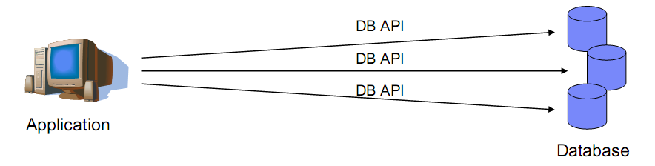
Universal Data Access (Native API)
Database management systems provide APIs that allow application programmers to create and access databases
The set of APIs that each manufacturer's system supplies is unique to that manufacturer. Microsoft has long recognized that it is inefficient and error prone for an applications programmer to attempt to master and use all the APIs for the various available database management systems
What's more, if a new database management system is released, an existing application can't make use of it without being rewritten to understand the new APIs

Slide 7
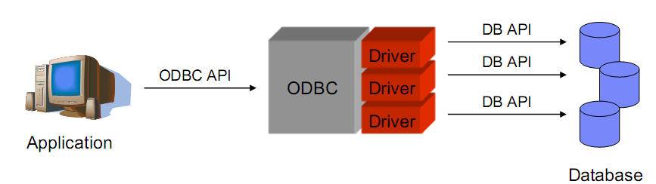
Open Database Connectivity (ODBC)
Open Database Connectivity (ODBC) helped address the problem of needing to know the details of each DBMS used. ODBC provides a single interface for accessing a number of database systems
ODBC provides a driver model for accessing data. Any database provider can write a driver for ODBC to access data from their database system. This enables developers to access that database through the ODBC drivers instead of talking directly to the database system

Slide 8
OLEDB and ADO (ActiveX Data Objects)
OLE-DB is also much less dependent upon the physical structure of the database. It supports both relational and hierarchical data sources, and does not require the query against these data sources to follow a SQL structure
Microsoft introduced ActiveX Data Objects (ADO) primarily to provide a higher-level API for working with OLE-DB. With this release, Microsoft took many of the lessons from the past to build a lighter, more efficient, and more universal data access API

Slide 9
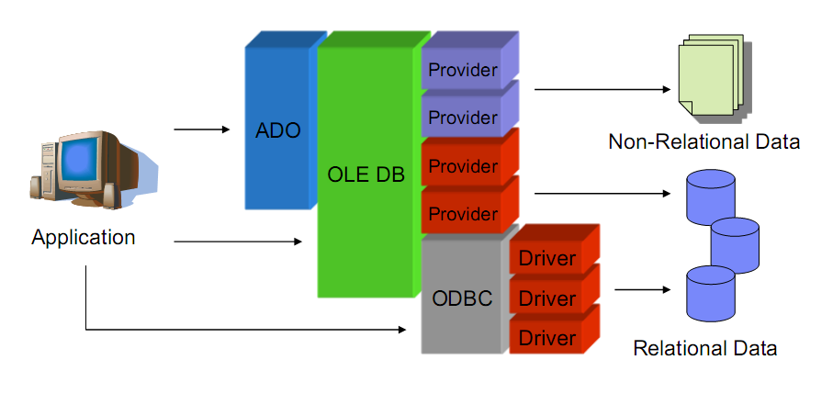
OLEDB and ADO (ActiveX Data Objects)

Slide 10
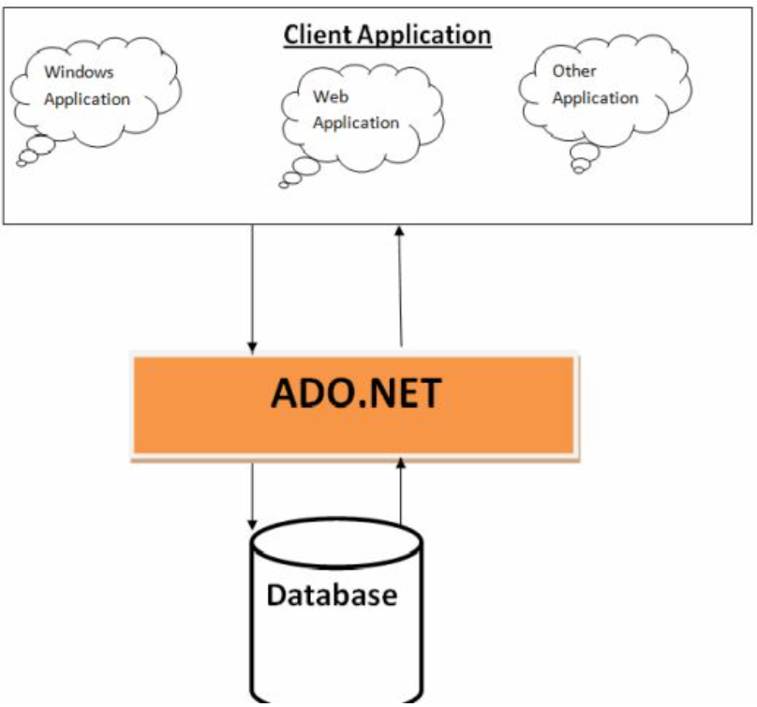
ADO.NET Overview
Is the data access technology, which allows to access data from various data sources
Is a part of .NET: The technology can be used for all .NET-base applications
Supports disconnected data architecture: Connection to the data source is established only required

Slide 11
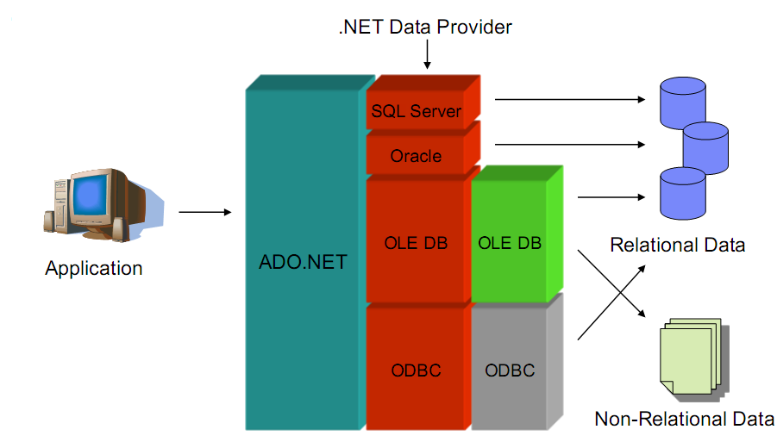
ADO.NET Overview

Slide 12
ADO.NET Overview
ADO.NET provides consistent access to data sources such as SQL Server and XML, and to data sources exposed through OLE DB and ODBC
Use XML to interact with the database: All the data in the database is converted into XML format for database related operations
Data-sharing consumer applications can use ADO.NET to connect to these data sources and retrieve, handle, and update the data that they contain
ADO.NET separates data access from data manipulation into discrete components that can be used separately or in tandem

Slide 13
ADO.NET Overview
ADO.NET provides functionality to developers who write managed code similar to the functionality provided to native component object model (COM) developers by ActiveX Data Objects (ADO)
ADO.NET includes .NET data providers for connecting to a database, executing commands, and retrieving results. Those results are either processed directly, placed in an ADO.NET DataSet object in order to be exposed to the user in an ad hoc manner, combined with data from multiple sources, or passed between tiers
The DataSet object can also be used independently of a .NET data provider to manage data local to the application or sourced from XML
ADO.NET separates data access from data manipulation into discrete components that can be used separately or in tandem

Slide 14
ADO.NET Features
Asynchronous processing: Enable time-consuming application running in the background
Multiple Active Result Sets (MARS): Allow to execute multiple batches in a connection
Bulk copy operations: Allow to copy large files into tables or views
Batch processing
Tracing: Monitor the excution of code, identify problems when executing code and fix them
Connection pooling control: Collects all the opened Database connections in a connection pool and get a connection from the pool for client rather than create new one

Slide 15
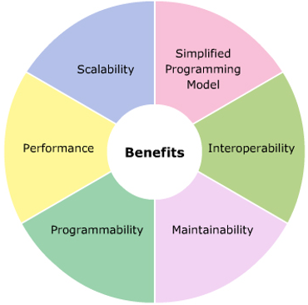
Benefits of ADO.NET
Asynchronous processing: Enable time-consuming application running in the background
Simplified Programming Model
Interoperability: XML is the default format used for transmitting datasets across network, any component can read XML format is able to process data
Maintainability and Programmability
Performance: Does not require data-type conversion while transmitting data through the tier
Scalability

Slide 16
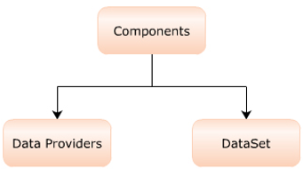
ADO.NET Architecture
The two important components of ADO.NET used for processing the data in Database are:
Data providers: Provide and maintain connection to the database
Dataset: Is the required portion in database that is extracted and maintained in the form of a table as a local copy in the client system

Slide 17
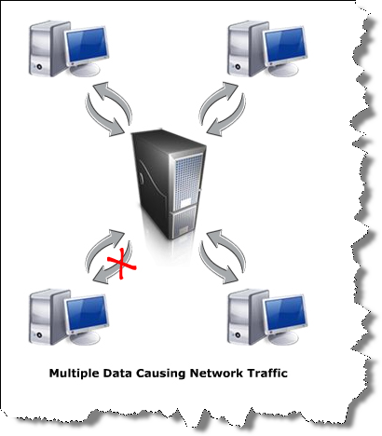
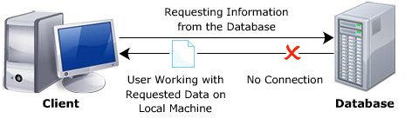
Data Access Models of ADO.NET
Connected data access:
Connection to the DB is established when requested by an application
This connection is kept open till the application is closed
Disconnected data access:
Connection to the DB is established when the application forwards a request
Once the request is processed, connection is automatically closed

Slide 18
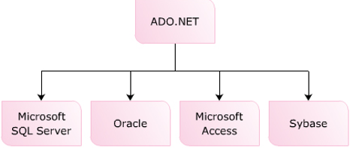
.NET Data Providers
A .NET data provider is used for connecting to a database, executing commands, and retrieving results. Those results are either processed directly, placed in a DataSet in order to be exposed to the user as needed, combined with data from multiple sources, or remoted between tiers
NET data providers are lightweight, creating a minimal layer between the data source and code, increasing performance without sacrificing functionality

Slide 19
.NET Data Providers
As with all of .NET (.NET Core), data providers ship as NuGet packages. There are several supported by Microsoft as well as a multitude of third-party providers available
The followings table documents some of the data providers supported by Microsoft:
.NET Data Provider | Namespace/NuGet Package Name
Microsoft SQL Server | Microsoft.Data.SqlClient
ODBC | System.Data.Odbc
OLE DB (Windows only) | System.Data.OleDb
Oracle Data Provider for .NET (ODP.NET) supported by Oracle in Nuget Package

Slide 20
Core Objects of .NET Data Providers
Base Class | Interface | Description
DbConnection | IDbConnection | Provides the ability to connect to and disconnect from the data store. Connection objects also provide access to a related transaction object
DbCommand | IDbCommand | Represents a SQL query or a stored procedure. Command objects also provide access to the provider’s data reader object
DbDataReader | IDataReader, IDataRecord | Provides forward-only, read-only access to data using a server-side cursor
DbDataAdapter | IDataAdapter, IDbDataAdapter | Transfers DataSets between the caller and the data store. Data adapters contain a connection and a set of four internal command objects used to select, insert, update, and delete information from the data store
DbParameter | IDataParameter, IDbDataParameter | Represents a named parameter within a parameterized query
DbTransaction | IDbTransaction | Encapsulates a database transaction

Slide 21
Core Objects of .NET Data Providers
The following table outlines the four core objects that make up a .NET data provider:
Object | Description
Connection | Establishes a connection to a specific data source. The base class for all Connection objects is the DbConnection class
Command | Executes a command against a data source. Exposes Parameters and can execute in the scope of a Transaction from a Connection. The base class for all Command objects is the DbCommand class
DataReader | Reads a forward-only, read-only stream of data from a data source. The base class for all DataReader objects is the DbDataReader class
DataAdapter | Populates a DataSet and resolves updates with the data source. The base class for all DataAdapter objects is the DbDataAdapter class

Slide 22
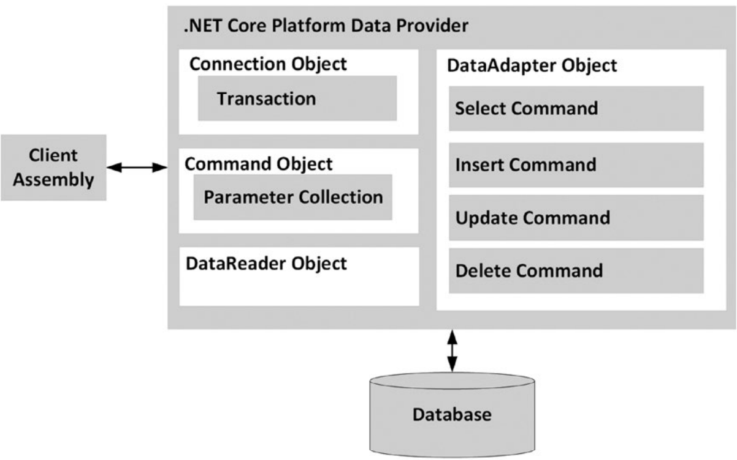
Core Objects of .NET Data Providers

Slide 23
System.Data Namespace
This namespace contains types that are shared among all ADO.NET data providers, regardless of the underlying data store
System.Data contains types that represent various database primitives (e.g., tables, rows, columns, and constraints), as well as the common interfaces implemented by data provider objects
Type | Description
Constraint | Represents a constraint for a given DataColumn object
DataColumn | Represents a single column within a DataTable object
DataRelation | Represents a parent-child relationship between two DataTable objects
DataRow | Represents a single row within a DataTable object
DataSet | Represents an in-memory cache of data consisting of any number of interrelated DataTable objects

Slide 24
System.Data Namespace
Type | Description
DataTable | Represents a tabular block of in-memory data
DataTableReader | Allows us to treat a DataTable as a fire-hose cursor (forward-only, read-only data access)
DataView | Represents a customized view of a DataTable for sorting, filtering, searching, editing, and navigation
IDataAdapter | Defines the core behavior of a data adapter object
IDataParameter | Defines the core behavior of a parameter object
IDataReader | Defines the core behavior of a data reader object
IDbCommand | Defines the core behavior of a command object
IDbDataAdapter | Extends IDataAdapter to provide additional functionality of a data adapter object
IDbTransaction | Defines the core behavior of a transaction object

Slide 25
ADO.NET Data Provider Factory Model
The .NET data provider factory pattern allows us to build a single codebase using generalized data access types
The classes within a data provider all derive from the same base classes defined within the System.Data.Common namespace:
DbCommand: The abstract base class for all command classes
DbConnection: The abstract base class for all connection classes
DbDataAdapter: The abstract base class for all data adapter classes
DbDataReader: The abstract base class for all data reader classes
DbParameter: The abstract base class for all parameter classes
DbTransaction: The abstract base class for all transaction classes

Slide 26
ADO.NET Data Provider Factory Model Demonstration

Slide 27
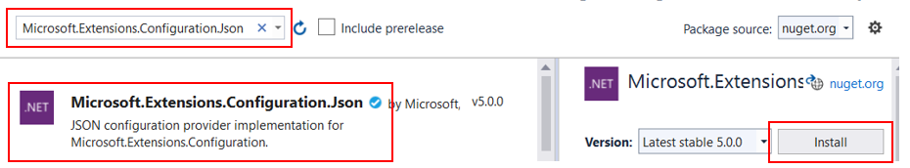
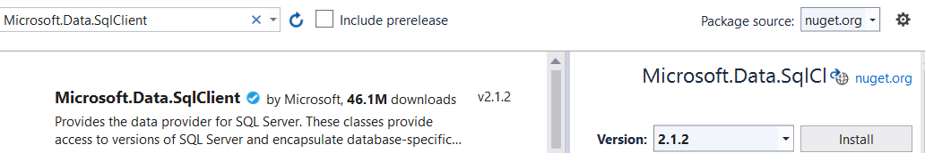
1.Create a Console app named DemoDataProviderFactory
2.Install 02 packages from Nuget: Right-click on the Project, seclect Manage Nuget Package… , search package name then click install as follows:
1
2
3
4

Slide 28
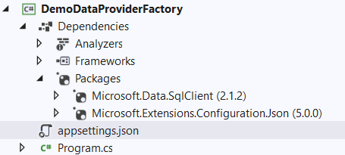
3. Right-click on the project | Add | New Item, select JavaScript JSON Configuration File then rename to appsettings.json , click Add and write contents as follows:
{
"ConnectionString": {
"MyStoreDB": "Server=(local);uid=sa;pwd=123;database=MyStore"
}
}

Slide 29
4.Right-click on the project, select Edit Project File and write config information as follows then press Crtl+S to save:
<Project Sdk="Microsoft.NET.Sdk">
<PropertyGroup>
<OutputType>Exe</OutputType>
<TargetFramework>net5.0</TargetFramework>
</PropertyGroup>
<ItemGroup>
<PackageReference Include="Microsoft.Data.SqlClient" Version="2.1.2" />
<PackageReference Include="Microsoft.Extensions.Configuration.Json" Version="5.0.0" />
</ItemGroup>
<ItemGroup>
<None Update="appsettings.json">
<CopyToOutputDirectory>Always</CopyToOutputDirectory>
</None>
</ItemGroup>
</Project>
5. Write codes for the Program.cs as follows then press Crtl+F5 to run project:

Slide 30
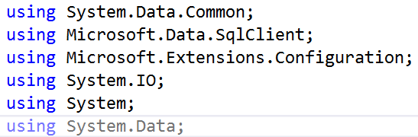
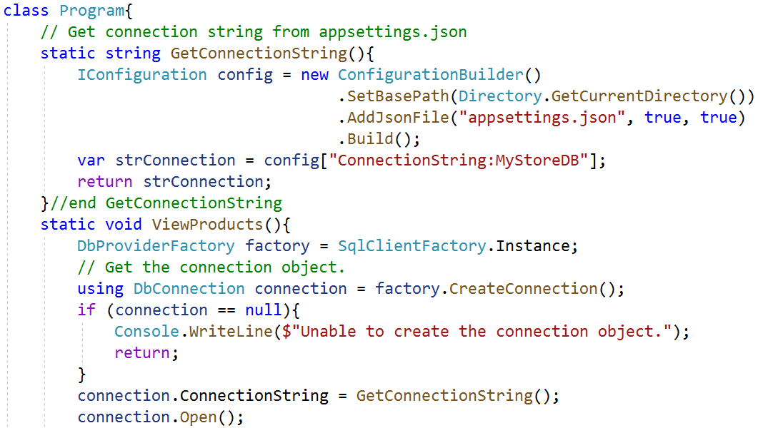

Slide 31
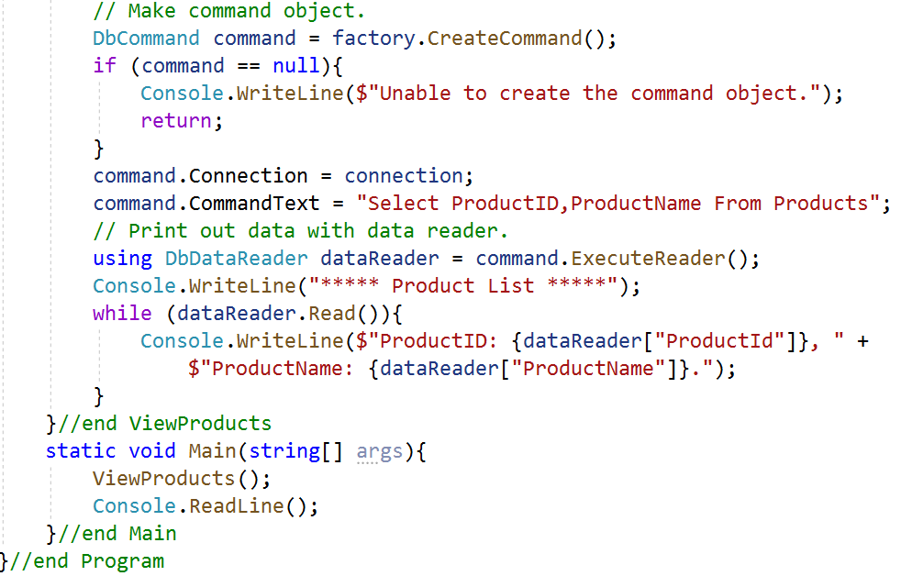
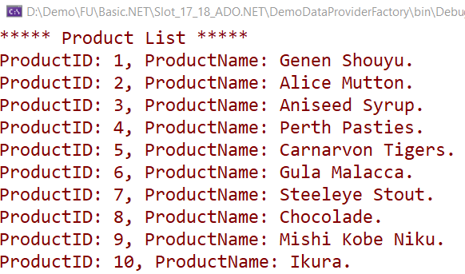

Slide 32
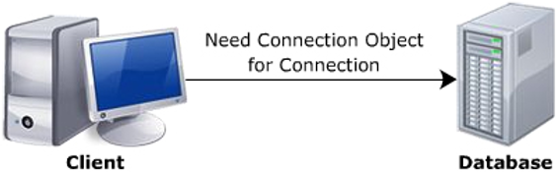
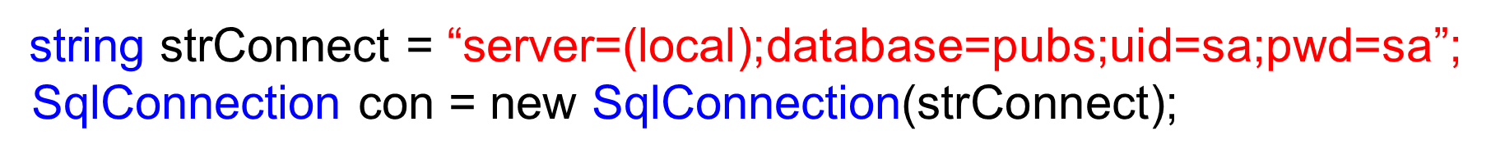
Connection Objects
Establish a session with the data source
ConnectionString property: identify the name of the machine we wish to connect to, required security settings, the name of the database on that machine, and other data provider–specific information
Properties | ConnectionString, State
Methods | CreateCommand, Open, Close
Event | StateChange

Slide 33
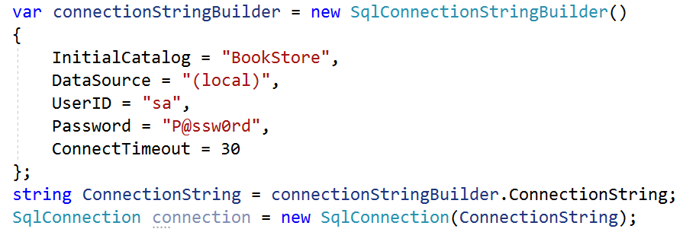
ConnectionStringBuilder Objects
The .NET compliant data providers support connection string builder objects, which allow us to establish the name-value pairs using strongly typed

Slide 34
Command Objects
The SqlCommand,which derives from DbCommand, is an OO (object-oriented) representation of a SQL query, table name, or stored procedure
Parameterized queries execute much faster than a literal SQL string, in that they are parsed exactly once. To associate a parameter within a SQL query to a member in the command object’s parameters collection, prefix the SQL text parameter with an at @ symbol
The type of command is specified using the CommandType property, which includes:
StoredProcedure: The name of a stored procedure
TableDirect: The name of a table
Text: An SQL text command (Default)

Slide 35
Command Objects
Member | Description
CommandTimeout | Gets or sets the time to wait while executing the command before terminating the attempt and generating an error. The default is 30 seconds
Connection | Gets or sets the DbConnection used by this instance of the DbCommand
Parameters | Gets the collection of DbParameter objects used for a parameterized query
Cancel() | Cancels the execution of a command
ExecuteReader() | Executes a SQL query and returns the data provider’s DbDataReader object, which provides forward-only, read-only access for the result of the query
ExecuteNonQuery() | Executes a SQL nonquery (e.g., an insert, update, delete, or create table)
ExecuteScalar() | A lightweight version of the ExecuteReader() method that was designed specifically for singleton queries (e.g., obtaining a record count)
Prepare() | Creates a prepared (or compiled) version of the command on the data source. As we might know, a prepared query executes slightly faster and is useful when we need to execute the same query multiple times (typically with different parameters each time)

Slide 36
The DataSet
The ADO.NET DataSet is explicitly designed for data access independent of any data source. As a result, it can be used with multiple and differing data sources, used with XML data, or used to manage data local to the application
The DataSet object is central to supporting disconnected, distributed data scenarios with ADO.NET
The DataSet is a memory-resident representation of data that provides a consistent relational programming model regardless of the data source

Slide 37
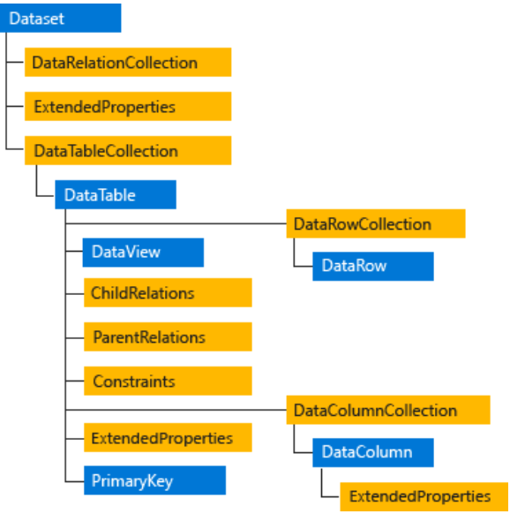
The DataSet
The DataSet contains a collection of one or more DataTable objects consisting of rows and columns of data, and also primary key, foreign key, constraint, and relation information about the data in the DataTable objects

Slide 38
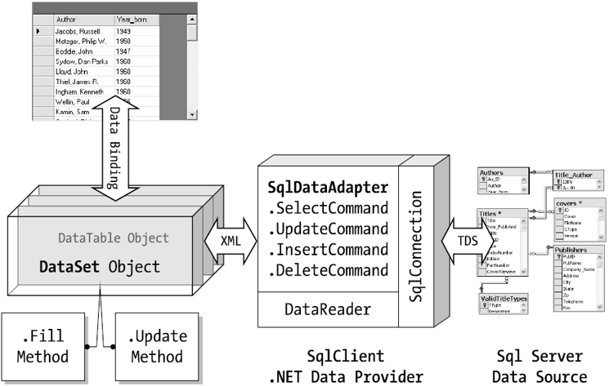
The DataSet

Slide 39
DataAdapter Objects
DataAdapter (which extends the abstract DbDataAdapter) is used to fetch and update data
DataAdapter objects make use of DataSet objects to move data between the caller and data source
DataAdapter objects move DataSets to and from the client tier
The DataAdapter handles the database connection automatically and keeps the connection open for the shortest possible amount of time
Once the caller receives the DataSet object, the connection is completely disconnected from the DBMS and left with a local copy of the remote data
The caller is free to insert, delete, or update rows from a given DataTable, but the physical database is not updated until the caller explicitly passes the DataSet to the data adapter for updating

Slide 40
Disconnected Data Access Demonstration

Slide 41
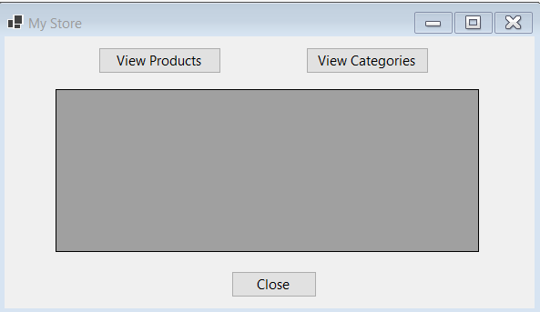
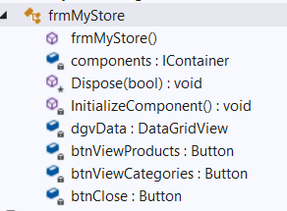
1.Create a Winform app named DemoDisconnectedLayer includes a form named frmMyStore and has controls as follows :
2.Trigger Click event of the buttons: btnClose, btnViewProducts, and btnViewCategories

Slide 42
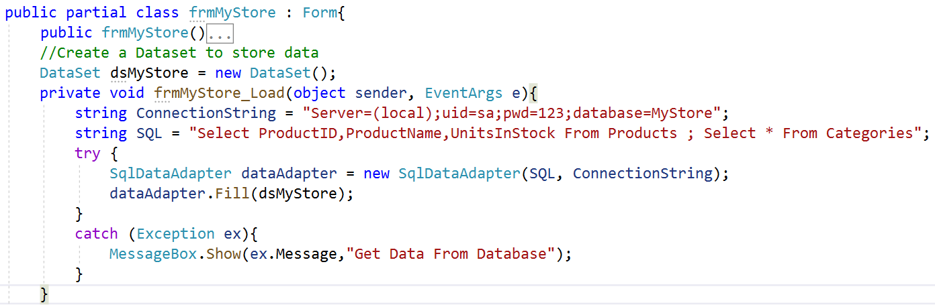
3.Trigger Load event of the frmMyStore form
4. Install Microsoft.Data.SqlClient package from Nuget package
5. Write codes in frmMyStore.cs as follows then press Ctrl+F5 to run project:

Slide 43
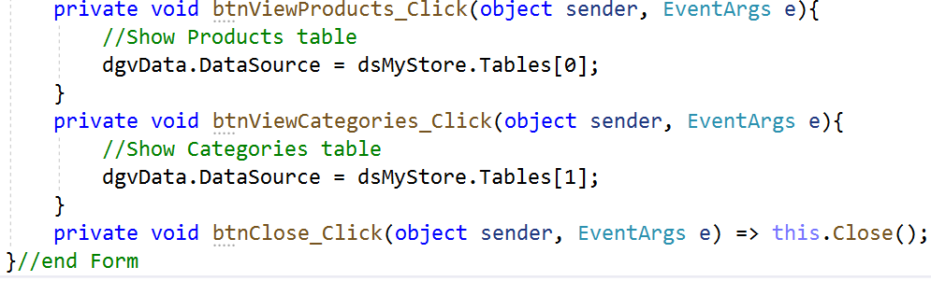
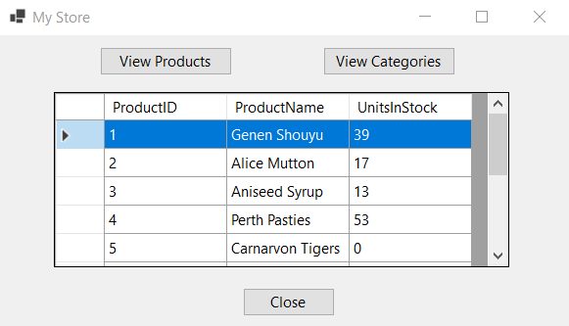
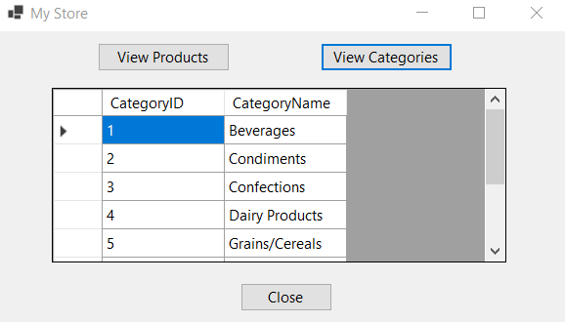

Slide 44
DataTable Objects
The DataTable class in ADO.NET is a database table representation and provides a collection of columns and rows to store data in a grid form
Properties | Description
Columns | Represents all table columns
Constraints | Represents all table constraints
DataSet | Returns the dataset for the table
DefaultView | Customized view of the data table
ChildRelation | Return child relations for the data table
ParentRelation | Returns parent relations for the data table
PrimaryKey | Represents an array of columns that function as primary key for the table
Rows | All rows of the data table
Method | Description
AcceptChanges | Commits all the changes made since last AcceptChanges was called
Clear | Deletes all data table data
Clone | Creates a clone of a DataTable including its schema
Copy | Copies a data table including its schema
NewRow | Creates a new row, which is later added by calling the Rows.Add method
RejectChanges | Reject all changed made after last AcceptChanges was called

Slide 45
DataView Objects
Represents a databindable, customized view of a DataTable for sorting, filtering, searching, editing, and navigation
The DataView does not store data, but instead represents a connected view of its corresponding DataTable
Properties | Description
RowFilter | Gets or sets the expression used to filter which rows are viewed in the DataView
Sort | Gets or sets the sort column or columns, and sort order for the DataView
Table | Gets or sets the source DataTable
Methods | Description
Find(Object) | Finds a row in the DataView by the specified sort key value
FindRows(Object) | Returns an array of DataRowView objects whose columns match the specified sort key value

Slide 46
DataReaders Objects
The DbDataReader type (which implements IDataReader) is the simplest and fastest way to obtain information from a data store. Recall that Data readers represent a read-only, forward-only stream of data returned one record at a time
Increases the application performance. However, the DataReader object requires an exclusive use of an open connection object fot its whole life span
Data readers are useful when we need to iterate over large amounts of data quickly and we do not need to maintain an in-memory representation

Slide 47
Connected Data Access Demonstration

Slide 48
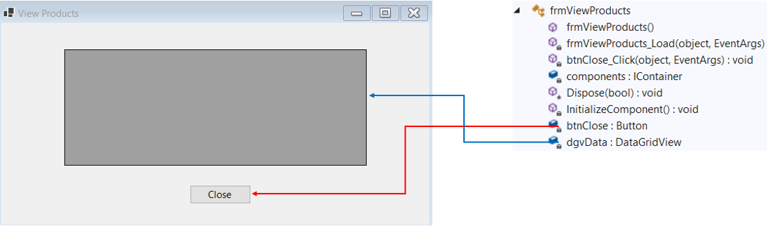
1.Create a Winform app named DemoConnectedLayer includes a form named frmViewProducts and has controls as follows :
2.Trigger Click event of the btnClose button and Load event of frmViewProducts form
3. Install Microsoft.Data.SqlClient package from Nuget

Slide 49
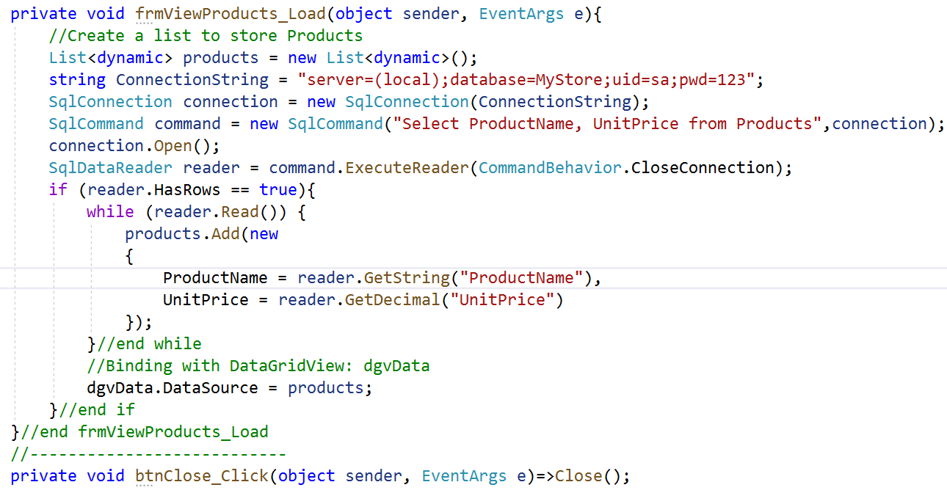
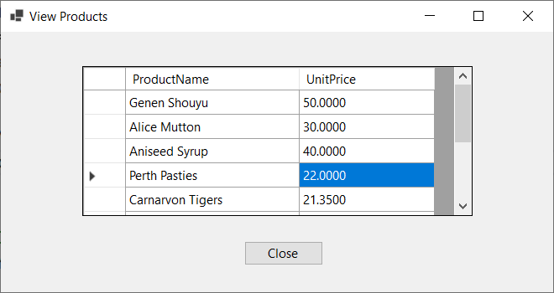
4. Write codes in frmViewProducts.cs as follows then press Ctrl+F5 to run project:

Slide 50
Create, Update, Delete and Queries Demonstration

Slide 51
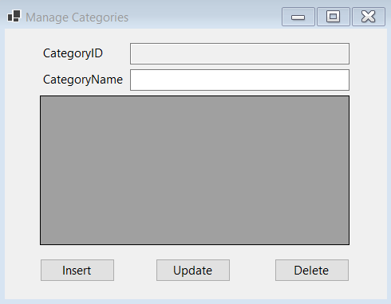
1.Create a Winform app named ManageCategoriesApp includes a form named frmManageCategories and has controls as follows :
Object Type | Object name | Properties / Events
Label | lbCategoryID | Text: CategoryID
Label | lbCategoryName | Text: CategoryName
TextBox | txtCategoryID | ReadOnly: True
TextBox | txtCategoryName
Button | btnInsert | Text: Insert Event Handler: Click
Button | btnUpdate | Text: Update Event Handler: Click
Button | btnDelete | Text: Delete Event Handler: Click
DataGridView | dgvCategories | ReadOnly: True SelectionMode:FullRowSelect
Form | frmManageCategories | StartPosition: CenterScreen Text: Manage Categories Event Handler: Load

Slide 52
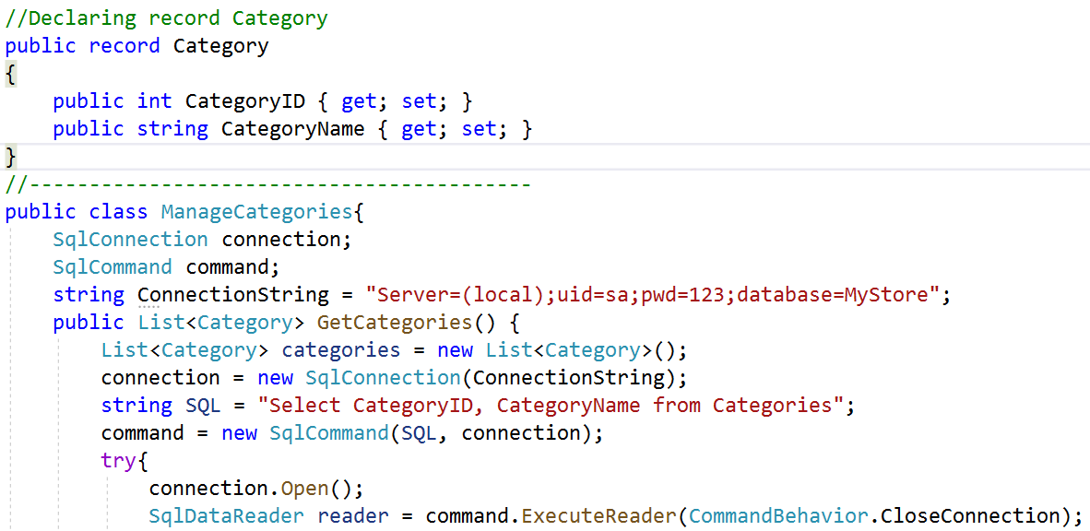
2.Right-click on the project | Add | Class, named ManageCategories.cs then write codes as follows:

Slide 53
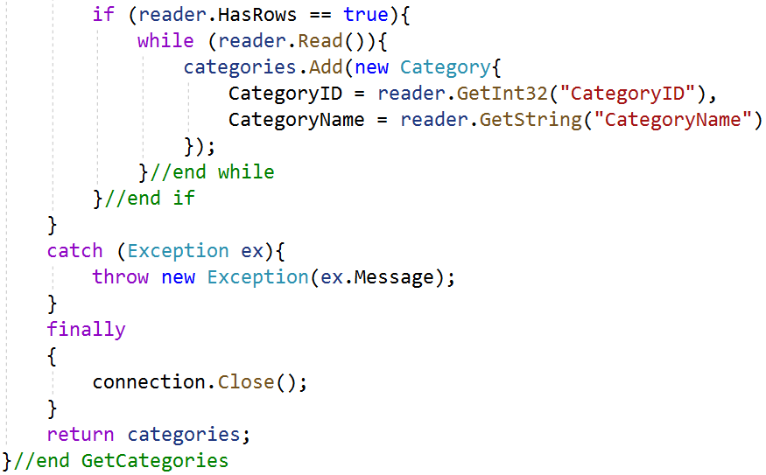
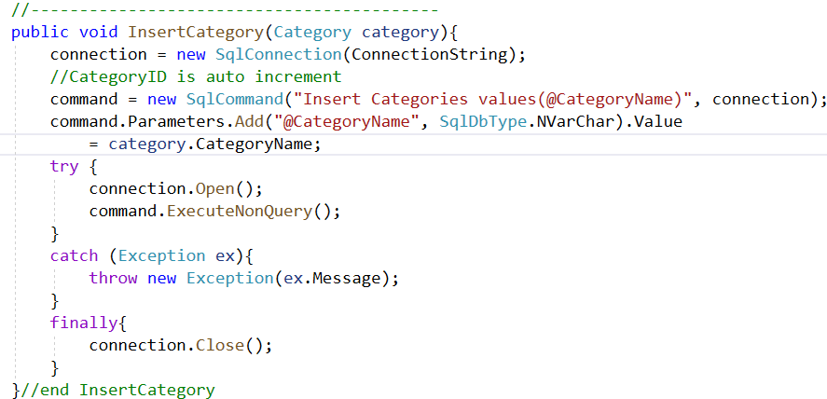

Slide 54
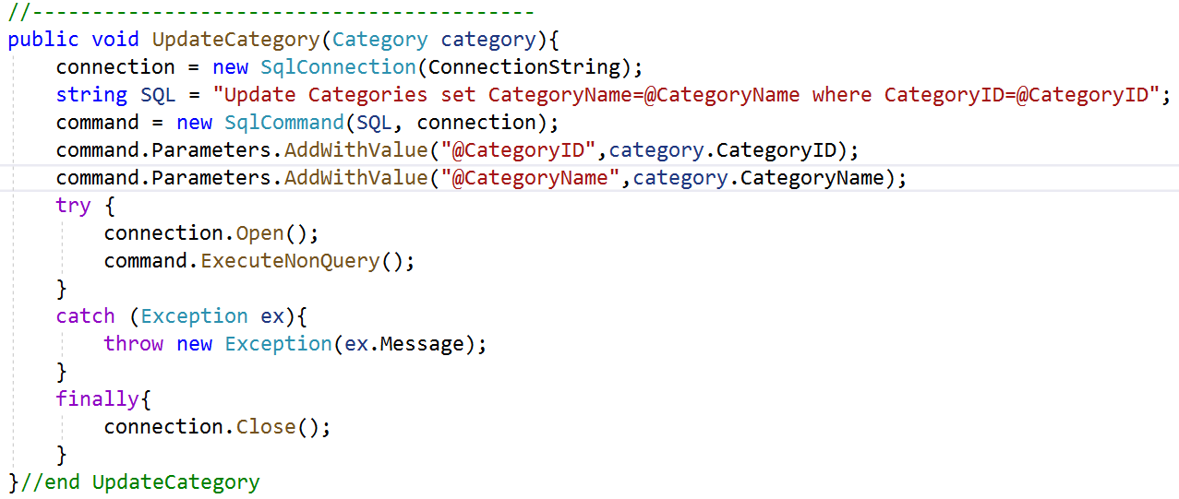

Slide 55
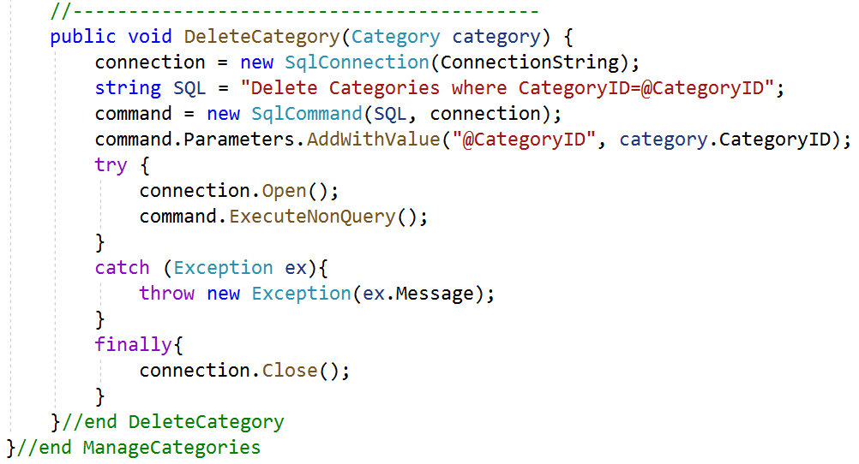
3.Write codes in frmManageCategories.cs as follows then press Ctrl+F5 to run project:

Slide 56
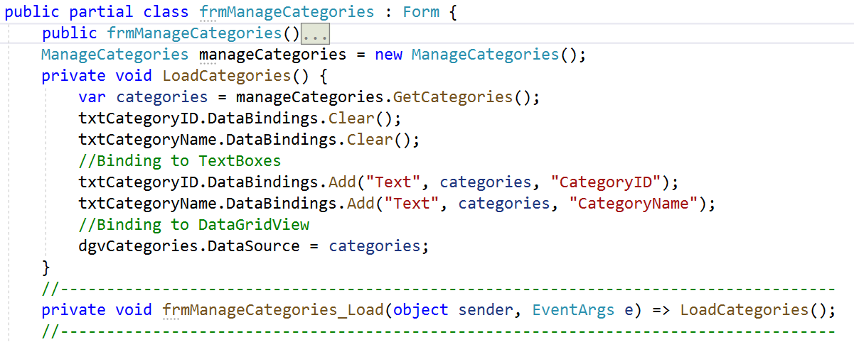

Slide 57
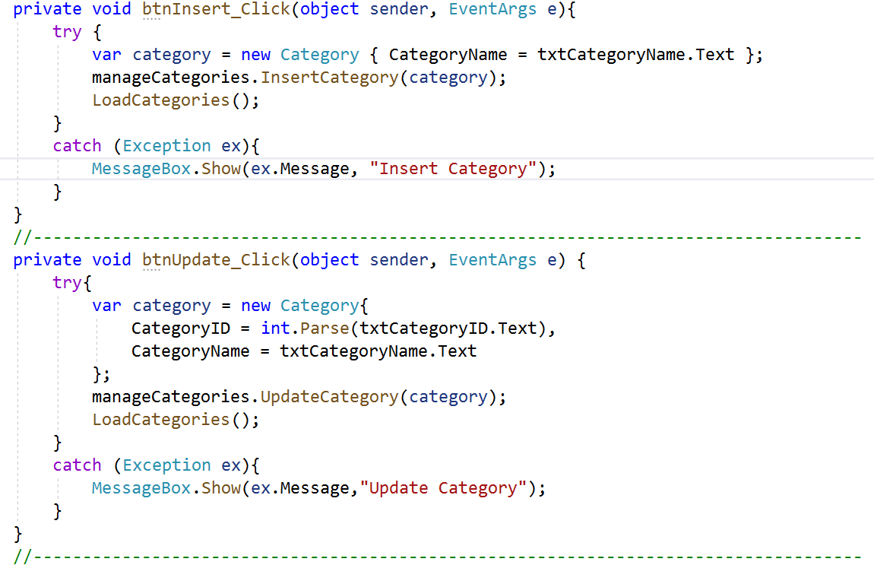

Slide 58
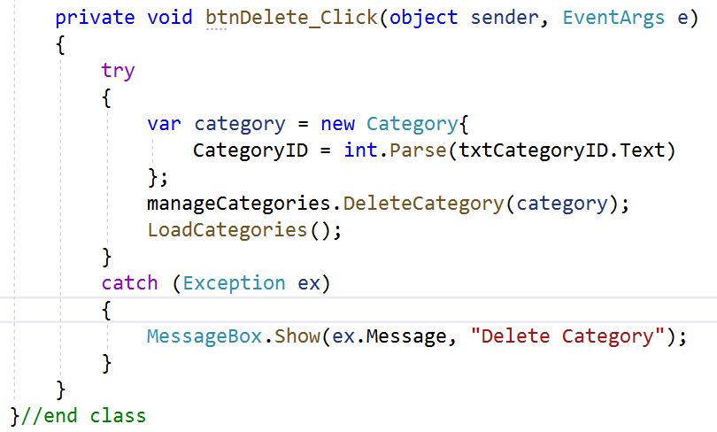
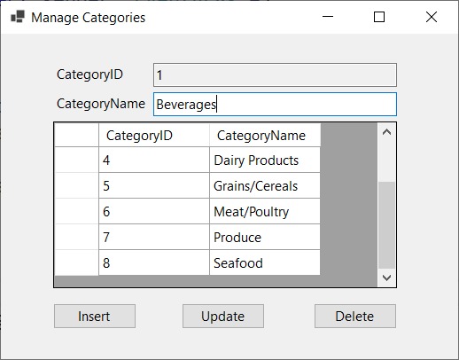

Slide 59
Working with Store Procedures
Stored procedures stored in the database which are a key ingredient in any successful large-scale database applications
One advantage of stored procedures is improved performance. Stored procedures typically execute faster than ordinary SQL statements because the database can create, optimize, and cache a data access plan in advance
Stored procedures also have a number of other potential benefits as follows:
Improve security. A client can be granted permissions to execute a stored procedure to add or modify a record in a specify way, without having full permissions on the underlying tables

Slide 60
Benefits of Store Procedures
Improve security. A client can be granted permissions to execute a stored procedure to add or modify a record in a specify way, without having full permissions on the underlying tables
Are easy to maintain, because they are stored separately from the application code. Thus, we can modify a stored procedure without recompiling and redistributing the .NET application that uses it
Add an extra layer of indirection, potentially allowing some database details to change without breaking your code. For example, a stored procedure can remap field names to match the expectations of the client program
Reduce network traffic, because SQL statements can be executed in batches

Slide 61
Store Procedures Demonstration
Create store procedures to count Products by CategoryID
Use MyStore
GO
Create Proc spCountProductsUsingOutputValue(@CategoryID int,@NumberOfProducts int Output) As
Select @NumberOfProducts = Count(ProductID)
From Products
where CategoryID = @CategoryID
Group by CategoryID
GO
Create Proc spCountProductsUsingReturnValue(@CategoryID int) As
Declare @NumberOfProducts int
Select @NumberOfProducts = Count(ProductID)
From Products
where CategoryID = @CategoryID
Group by CategoryID
Return @NumberOfProducts
Create Console App then write codes as follows:

Slide 62
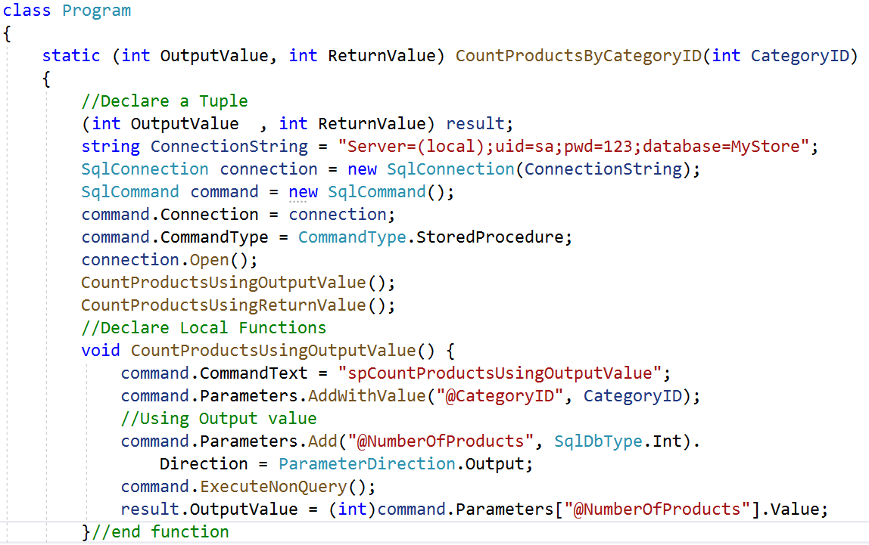

Slide 63
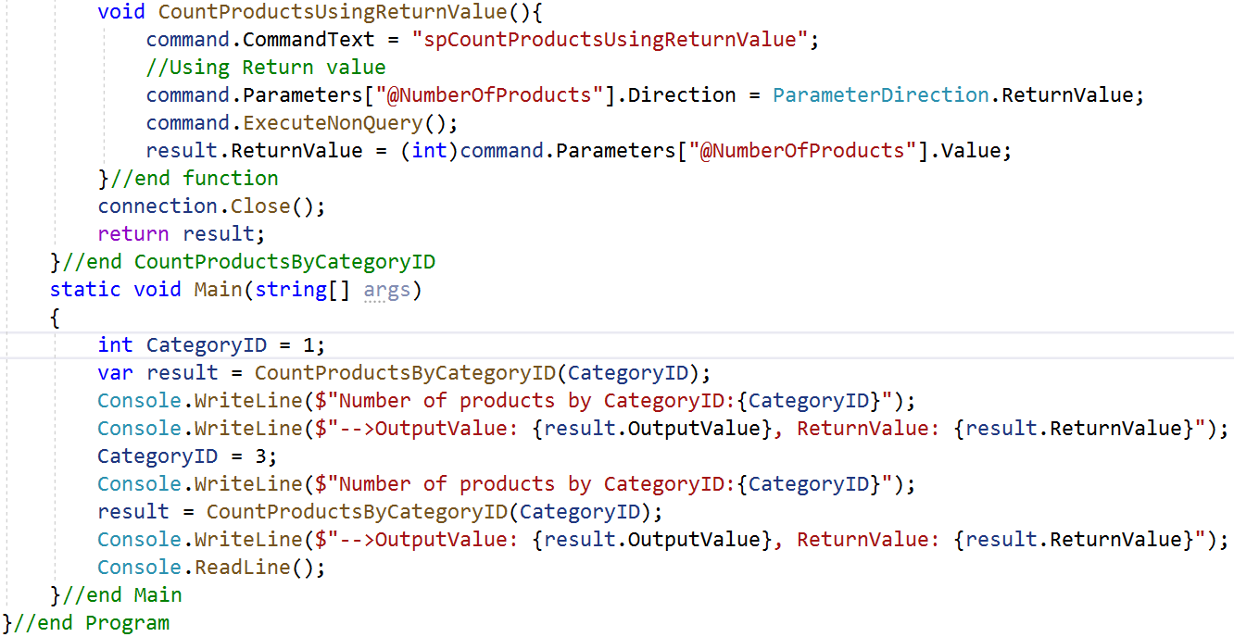
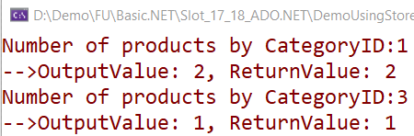

Slide 64
What is .NET 3-Layers Architecture?
Three-layer architecture is dividing the project into three layers that are User interface layer, Business layer and Data (database) layer where we separate UI, Logic, and Data in three divisions
Suppose we want to change the UI from windows to the phone than he has to only make change in UI layer, other layers are not affected by this change Similarly, if the we want to change the database then we have to only make a change in the data layer, rest everything remains the same

Slide 65
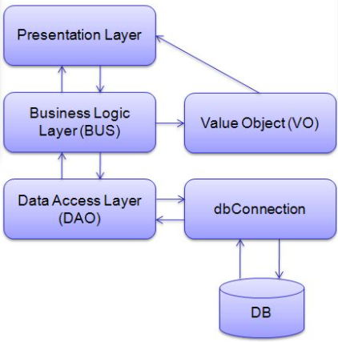



The .NET 3-Layers Architecture

Slide 66

What is .NET 3-Layers Architecture?
Presentation Layer
This is the top layer of architecture. The topmost level of application is the user interface
It is related to the user interface that is what the user sees. The main function of this layer is to translate tasks and results in something which the user can understand
It contains pages like web forms, windows form where data is presented to the user and use to take input from the user. The presentation layer is the most important layer because it is the one that the user sees and good UI attracts the user and this layer should be designed properly

Slide 67
What is .NET 3-Layers Architecture?
Business Layer
This is the middle layer of architecture. This layer involves C# classes and logical calculations and operations are performed under this layer
It processes the command, makes logical decisions and perform calculations. It also acts as a middleware between two surrounded layers that is presentation and data layer
It processes data between these two layers. This layer implements business logic and calculations and validates the input conditions before calling a method from the data layer. This ensures the data input is correct before proceeding, and can often ensure that the outputs are correct as well. This validation of input is called business rules

Slide 68
What is .NET 3-Layers Architecture?
Data Layer
This layer is used to connect the business layer to the database or data source
It contains methods which are used to perform operations on database like insert, delete, update, etc
This layer contains stored procedures which are used to query database. Hence this layer establishes a connection with the database and performs functions on the database

Slide 69

What is 3-Tiers Architecture?
A 3-tier application architecture is a modular client-server architecture that consists of a Presentation tier, an Application tier and a Data tier
The data tier stores information, the application tier handles logic and the presentation tier is a graphical user interface (GUI) that communicates with the other two tiers. The three tiers are logical, not physical, and may or may not run on the same physical server

Slide 70

What is 3-Tiers Architecture?
Presentation Tier
The presentation tier is the front end layer in the 3-tier system and consists of the user interface
This user interface is often a graphical one accessible through a web browser or web-based application and which displays content and information useful to an end user
This tier is often built on web technologies such as HTML5, JavaScript, CSS, or through other popular web development frameworks, and communicates with others layers through API calls

Slide 71
What is 3-Tiers Architecture?
Application Tier: The application tier contains the functional business logic which drives an application’s core capabilities. It’s often written in Java, .NET, C#, Python, C++, etc
Data Tier: The data tier comprises of the database/data storage system and data access layer. Examples of such systems are MySQL, Oracle, PostgreSQL, Microsoft SQL Server, MongoDB, etc. Data is accessed by the application layer via API calls

Slide 72
Summary
Concepts were introduced:
ADO.NET is a data access technology – supports disconnected data architecture
A data provider establishes and maintains connection to the database. The .NET Framework provides various data providers which are used for SQL Server, OLE DB, ODBC
.NET Data Providers and Dataset are used for accessing data source and then storing the retrieved records into tables : Connection, Command, DataAdapter, DataReader, DataTable, DataView
Overview about 3-Layers and 3-Tiers Architecture
List the benefits of ADO.NET
Demo using ADO.NET Data Provider Factory Model
Demo accessing database in WinForm Application using ADO.NET
Demo using Store procedures in ADO.NET
Overview about 3-Layers and 3-Tiers Architecture

